Slide 1





MEDIGUIDE THE BRAIN STROKE PREDICITON APPLICATION
by- Kumar Gaurav (2021UCA1801)
Sparsh Singh (2021UCA1844)
Yash Kumar (2021UCA1855)

Slide 2

CONTENTS
01
02
03
04
Problem Statement
Contribution and Novelty
Introduction
Motivation
05
07
08
09
Literature Work
Software Required
Result and Observations
Methodology
10
11
Issues
Conclusion

Slide 3
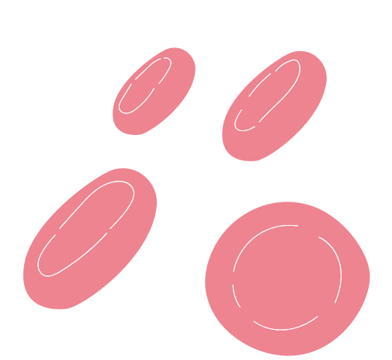
INTRODUCTION
THE MEDICAL DATA CLASSIFICATION FACES THE[3] IMBALANCED COUNT OF DATA SAMPLES. MACHINE LEARNING ALGORITHMS GENERALLY PERFORM BADLY ON SUCH MINORITY CLASSES.
Brain stroke is most general neurological reason for death and inability affecting approximately 16 million people worldwide.Machine learning can be used for early brain stroke detection to avoid mortality and inability.
The Dataset of our problem is highly imbalanced having 783 people out of 43,400 samples having stroke making general machine learning algorithms struggle to predict minority class accurately.
To resolve the given issue we balanced the dataset with respect to our baseline algorithm Artificial neural network(ANN)and then applied various machine and deep learning algorithms to get best accuracy,precision and recall.
For balancing dataset we used techniques like SMOTE and its variants like SMOTE-TOMEK,SMOTE-ENN,Borderline-SMOTEand our novel model SMOTEN which outperformed other dataset balancing techniques.
For max. accuracy of 99% and AUC score of 0.99 we did ensemble learning voting classifier on Random Forest Classifier(99%), and K-nearest neighbor(98%). We performed other techniques for comparison too like Logistic regression(81%),Ada boost(89%),Support Vector Machine(91%) etc.

Slide 4
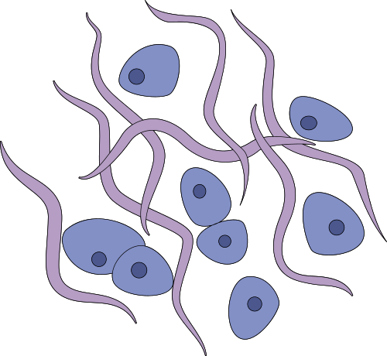

MOTIVATION
Imbalance nature of data in real-world like credit-card fraud,medical diagnosis etc.
Failure of general existing classification machine learning algorithms on minority class in such imbalance dataset.
Early detection of brain stroke prediction being major problem to solve with highest accuracy can save millions of lives and is a major motivational driving force to perform the given project.

Slide 5
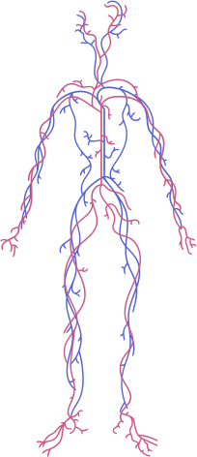

PROBLEM STATEMENT
The brain stroke detection medical dataset of our problem is highly imbalanced i.e. out of 43,400 samples only 783 people have stroke making machine learning algorithms difficult to predict minority class accurately.
This research paper aims to find an effective solution for handling imbalanced datasets, the first step of the solution is to find a novel way to balance the dataset in the best possible way and finding an algorithm that gives us the best accuracy out of all present existing models.

Slide 6


CONTRIBUTIONS AND NOVELTY
Contribution - Our project aims to find the best way to balance our stroke prediction dataset which is severely imbalanced as out of 43,400 people only 783 had stroke which is close to 1.8% of the total.
Novelty - For solving given problem we propose a model that is first balanced by SMOTEN technique then we do Ensemble learning voting classifier on the best performing models Random Forest (99% accuracy)and KNN(98% accuracy) and after voting classifier the accuracy that we get is 99% and the auc score is 0.990 which is highest.

Slide 7

LITERATURE WORK
The medical datasets like Brain Stroke are mostly imbalanced in their class labels. V. Krishna, J. Sasi Kiran [4] In this research study has used various machine learning (ML) algorithms like K nearest neighbor, logistic regression, random forest (RF) classifier and SVC. One of the given algorithms with high accuracy is used to design a model in this research work to predict strokes for new inputs.
S. Vasa, P. Borugadda and A. Koyyada in[5]research to develop the optimal model to predict brain stroke using Machine Learning Algorithms (MLA's), namely Logistic Regression (LR), Decision Tree Classifier (DTC), Random Forest Classifier (RFC), Naive Bayes Classifier(NBC), XGBoost Classifier(XGB), Support Vector Machine (SVC) and KNN Classifier (KNN). Apply GridSearchCV (CV=5) along with the above algorithms with hyperparameter on the given dataset. In the 7 models given XGB is the optimal model with 96.34% accuracy.
Study by S. U. Sabha and A. Assad [6] aims to evaluate the effectiveness of five oversampling strategies that are intended to address data imbalance, namely random oversampling, SMOTE, borderline SMOTE, ADASYN, and Deep SMOTE. On small and imbalanced dataset Deep SMOTE outperformed other techniques.
The proposed soft voting model[7] improved the accuracy and robustness of the final prediction compared to a single classifier. To resolve this problem, the future introduced a swarm intelligence-based optimization to improve classification accuracy. The accuracy of the proposed model is 96.88%.

Slide 8
METHODOLOGY
Data Cleaning And Preprocessing- In our dataset due to high number null values in smoking_status column we dropped all such instances and in BMI column due to low number of null instances we handle it by imputing median values.
Data Analysis-
1. Out of 43,400 instances only 783 have stroke and 42617 instances did not have stroke.
2. 4061 instances have hypertension out of them only 200 people have stroke
3. 2062 instances have heart disease out of them 177 have stroke.
4. Out of 25665 females and 17724 males,431 female have stroke and 352 males have stroke
5. Then we do the correlation analysis to analyze the correlation among the features.
Creating a baseline model using Artificial Neural Networks(ANN) - We first train ANN with imbalanced data and found that it completely fails in detecting stroke and then we balance the data using different techniques and again train the balanced data using ANN giving us maximum accuracy on balanced dataset we will select the technique and move further.

Slide 9
METHODOLOGY
Different Techniques For Balancing The Data-
Under sampling- We balance the dataset by randomly undersampling the majority class . This improves the performance of ANN in predicting stroke but gives accuracy of only 78% and f1 score for stroke is 0.79.
Oversampling-In this technique we balance the dataset by oversampling the majority class. This improves the performance of ANN in detecting stroke and gives accuracy of 81% and f1 score for stroke is 0.83 which is better than under sampling.
SMOTE(Synthetic Minority Oversampling Technique) -It creates synthetic instances on the line segments joined along random k nearest neighbors of minority class. This gives an accuracy of 83% and f1 score of 0.84 which is better than oversampling.
SMOTETomek - It is a smote variation combining oversampling minority class using SMOTE and then undersampling by removing data identified as Tomek links from majority class(samples closest to minority class).It gives an accuracy of 83% and f1 score of 0.84 which is same as SMOTE.

Slide 10
METHODOLOGY
SMOTE-ENN- ENN stands for Edited Nearest Neighbor. It uses SMOTE to oversample minority class and ENN to delete data from both classes identified as having different class between the observation’s class and its K-nearest neighbor majority class. It gives an accuracy of 87% and f1 score of .88 which is best till now
Adasyn-[9]The essential idea of ADASYN is to use a weighted distribution for different minority class examples according to their level of difficulty in learning, where more synthetic data is generated for minority class samples which are not as easy to learn as compared to minority samples. This gives an accuracy of 83% and f1 score of .84 which is the same as smote
SVM SMOTE-[10]It is a SMOTE variation which focuses on generating new minority class instances near borderlines with SVM so as to help establish boundaries between classes. This gives an accuracy of 89% and f1 score of .82 which is highest accuracy till now.
•BORDERLINE SMOTE-[11]This SMOTE variation uses only a few class samples on the border to combine new samples. Borderline SMOTE is divided into Noise, Danger and Safe categories. At last, a few number Danger samples were oversampled. This gives an accuracy of 91% and f1 score of .91 which is the highest accuracy till now.
SMOTEN- It stands for Synthetic Minority Over-sampling Technique for Nominal It expects that the data to resample are only made of categorical features. This gives an accuracy of 93% and f1 score of .93 which is highest accuracy till now.

Slide 11
METHODOLOGY
Ensembling best performing algorithms - So after all these techniques, we found that SMOTEN gives us the best-balanced data so we finalize this technique and then apply the other classification algorithms such as Random Forest Classifier, K nearest Neighbor, Logistic regression, Support vector machine, Adaboost, Naive Bias and we found that out of all models the KNN and random forest gives us the best result so we use ensemble learning voting classifier on them which gives us an accuracy of 99% and f1 score of .99 which is our proposed model for maximum accuracy
To summarize our research paper aims to find the effective solution of handling imbalanced datasets, first by balancing dataset with ANN as baseline algorithm and using different techniques like SMOTE and its variants like SMOTE,SMOTE-TOMEK,Borderline SMOTE,SMOTE-ENN etc. and our novel model SMOTE-EN which performed best among all and in the end for best accuracy we use ensemble learning voting classifier on best performing models among all i.e. on KNN(98%) and Random Forest Classifier(99%) after performing other algorithms as well giving overall maximum accuracy of 99% and auc score of 0.99.

Slide 12
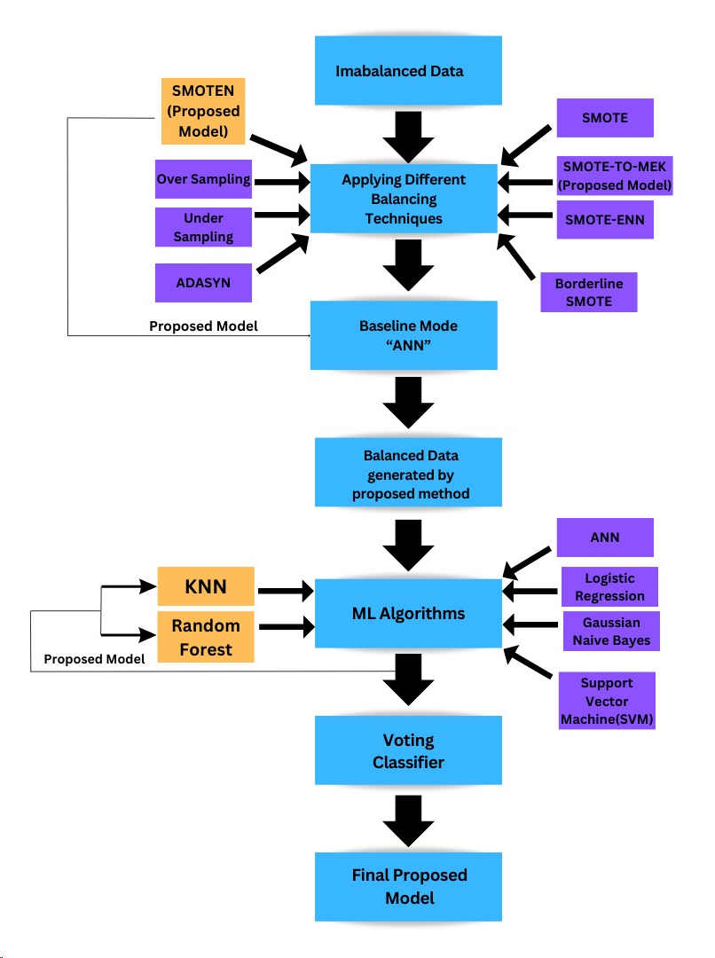

Slide 13



SOFTWARE REQUIRED
Jupyter notebook
GOOGLE COLLAB
ONLINE DRAWING SOFTWARES FOR TABLE AND FLOWCHART CREATION.
ANACONDA

Slide 14

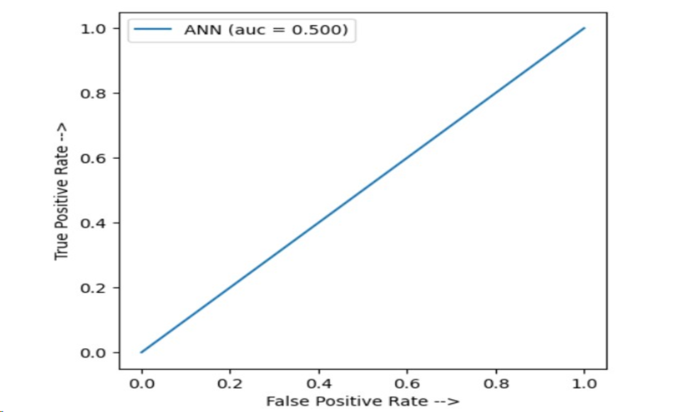
RESULT AND OBSERVATIONS
ANN is our baseline model which takes input data in input layer which by passing through hidden layers finally transforms into valuable data in the output layer. When ANN is fed with imbalanced data it gives precision and recall for stroke 0.00 and auc score 0f .50 which indicates that it does not determine stroke correctly.

Slide 15
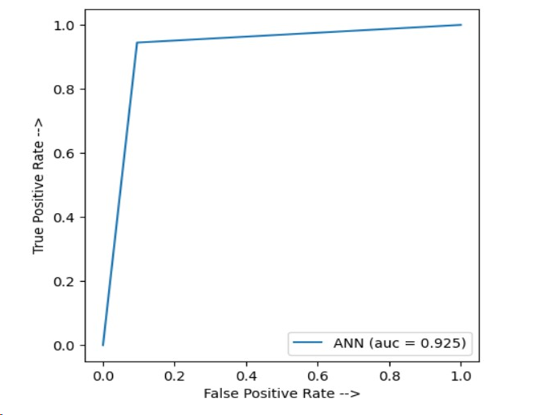
RESULT AND OBSERVATIONS
ANN when fed with the data balanced with our best proposed method i.e. SMOTE-EN it gives accuracy of 93% precision of .90 recall of .96 ,f1 score of 0.96 and AUC of 0.93 which is very good as compared to without sampling baseline model.

Slide 16
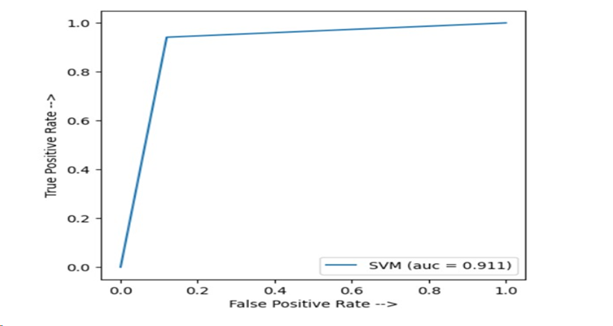
RESULT AND OBSERVATIONS
Support Vector Machine- It is supervised machine learning algorithm whose main objective is to find the optimal hyperplane in an N-dimensional space that can separate the data points in different classes in the feature space. When we fed the balanced data to SVM it gives accuracy of 91% precision of .89 recall of .94 ,f1 score of 0.91 and AUC of 0.911.

Slide 17
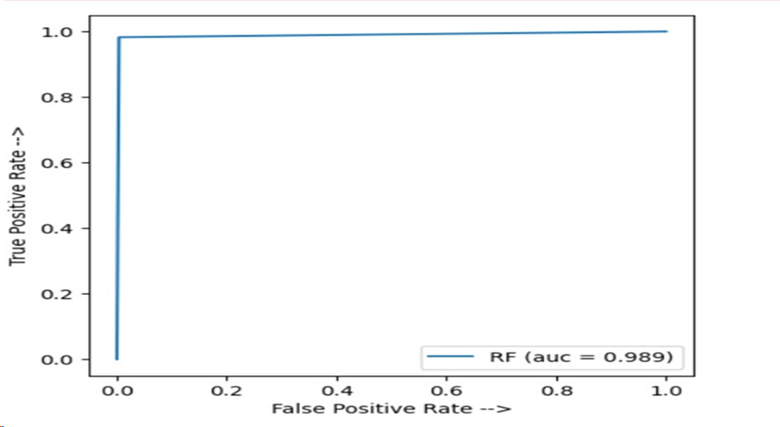
RESULT AND OBSERVATIONS
Random Forest is an ensemble of decision trees; it creates multiple decision trees and combines their predictions to make the final decision. The idea behind this is that multiple trees can work together to overcome the limitations of a single decision tree, such as overfitting, by reducing the variance and increasing the robustness of the model. When we fed the balanced data to random forest it gives accuracy of 99% precision of 1 recall of .98 ,f1 score of 0.99 and AUC of 0.989.

Slide 18
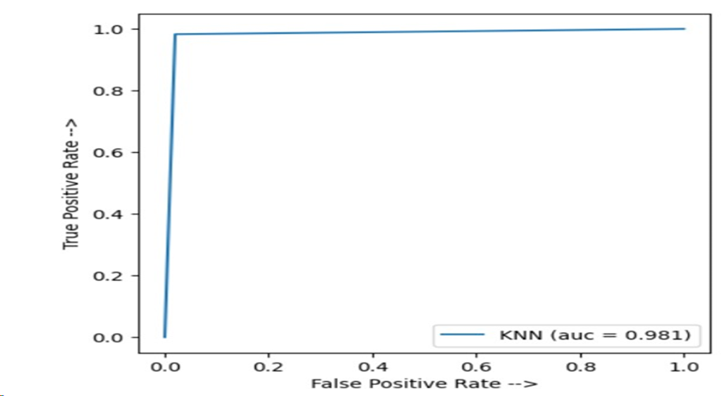
RESULT AND OBSERVATIONS
KNN is a non-parametric, instance-based learning algorithm. In KNN, the classification of a new data point is determined by the class of its K nearest neighbors in the feature space. It can handle imbalanced data by adjusting the number of nearest neighbours i.e. K, which controls the decision. When we fed the balanced data to random forest it gives accuracy of 98% precision of 0.98 recall of .98 ,f1 score of 0.98 and AUC of 0.981.

Slide 19
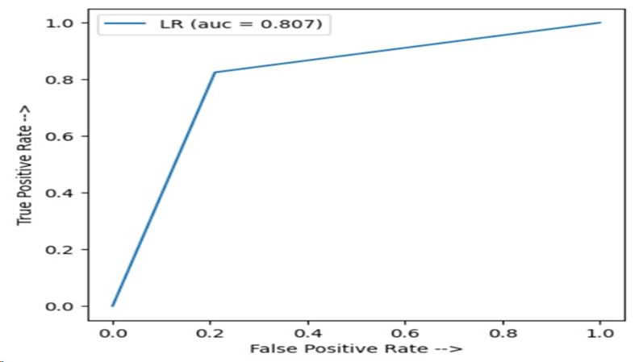
RESULT AND OBSERVATIONS
Logistic regression is a supervised machine learning algorithm mainly used for classification tasks where the goal is to predict the probability that an instance of belonging to a given class. When we fed the balanced data to Logistic Regression it gives accuracy of 81% precision of 0.80 recall of .82 ,f1 score of 0.81 and AUC of 0.807.

Slide 20
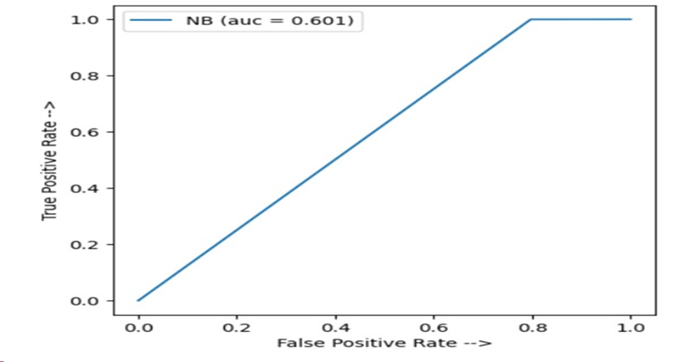
RESULT AND OBSERVATIONS
Gaussian Naive Bayes: It is a variant of the Naive Bayes algorithm that makes the assumption that the features are normally distributed, and it is called "naive" because it assumes that the features are independent of each other. When we fed the balanced data to Gaussian Naive Bayes it gives accuracy of 60% precision of 0.56 recall of 1 ,f1 score of 0.71 and AUC of 0.601.

Slide 21
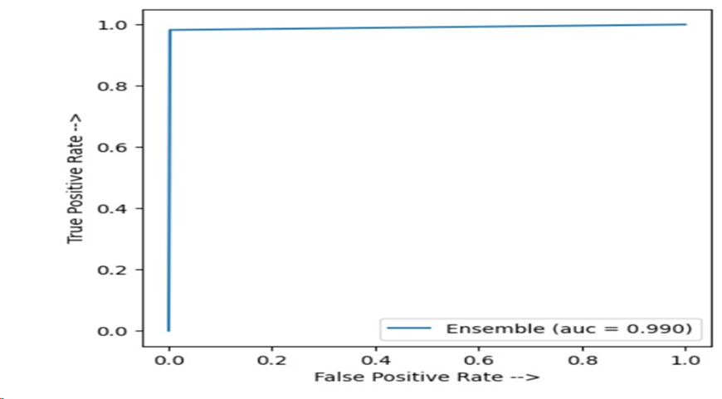
RESULT AND OBSERVATIONS
The voting classifier [22] is an ensemble learning method that works by aggregating the predictions of multiple base models to make a final prediction. The main reason for using a Voting Classifier is to improve the overall accuracy and robustness of the model. In our model we combine random forest and KNN the two best performing models to achieving best accuracy out of all algorithms. when we fed the balanced data to Logistic Regression it gives accuracy of 99% precision of 1 recall of .98 ,f1 score of 0.99 and AUC of 0.990.

Slide 22
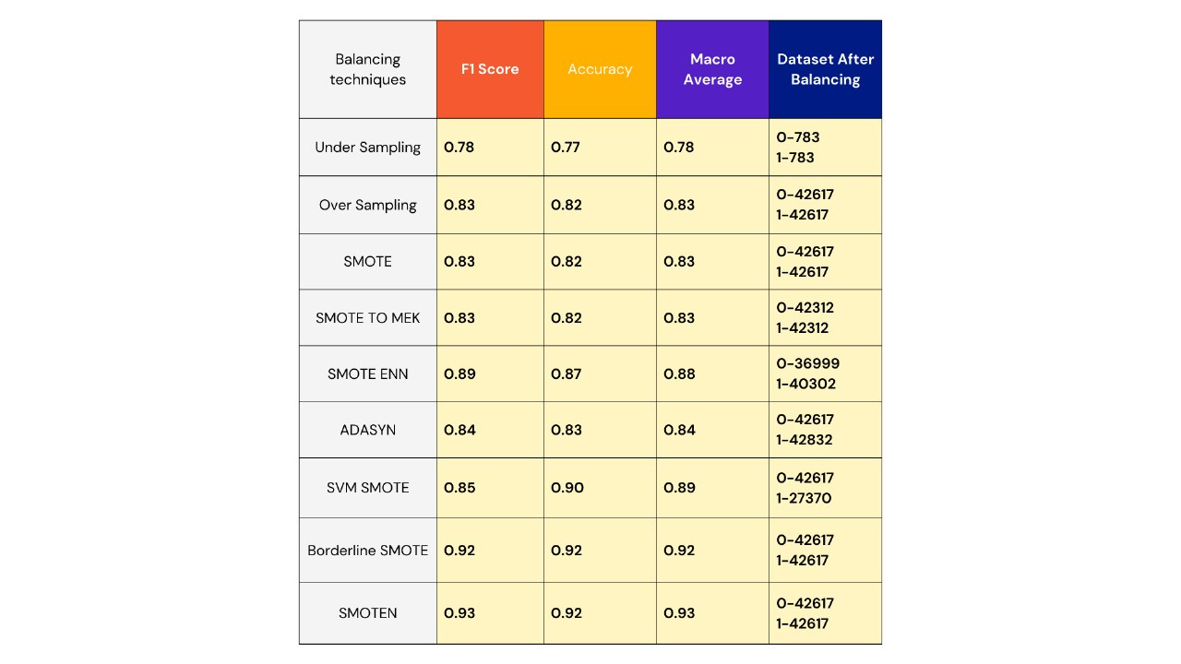
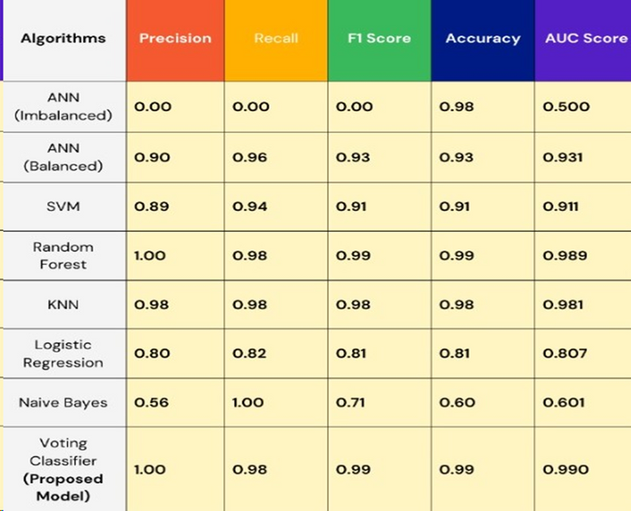
RESULT AND OBSERVATIONS
From the results obtained we can observe that SMOTEN is the best technique for sampling and voting classifier with random forest and KNN is giving the highest accuracy

Slide 23


ISSUES
The main issue we faced during this project is to find the correct technique which gives generates the dataset that gives maximum accuracy as while testing we came across various techniques for handling imbalanced datasets with each giving different accuracy.
Another issue we faced is finding the correct machine learning algorithm which gives us the maximum accuracy on our balanced dataset.

Slide 24

CONCLUSION
In a world that is heavily dependent on data the problem of class Imbalance is one of the major problem especially in the field of medicines as it is difficult to deal with Imbalanced data using machine learning algorithms so by this research work the main aim is to tackle the challenge of handling Imbalanced datasets and provide a useful and best solution to the problem so we propose a model that balance the Imbalanced dataset using SMOTEN technique which is a variation of SMOTE then after that we apply ensemble learning voting classifier on our two best performing algorithms that are Random Forest Classifier and KNN and this gives us the result with maximum accuracy of 99% with AUC score of 0.990.
https://github.com/SinghSparsh/MEDIGUIDE

Slide 25



THANK YOU

